Slide 1
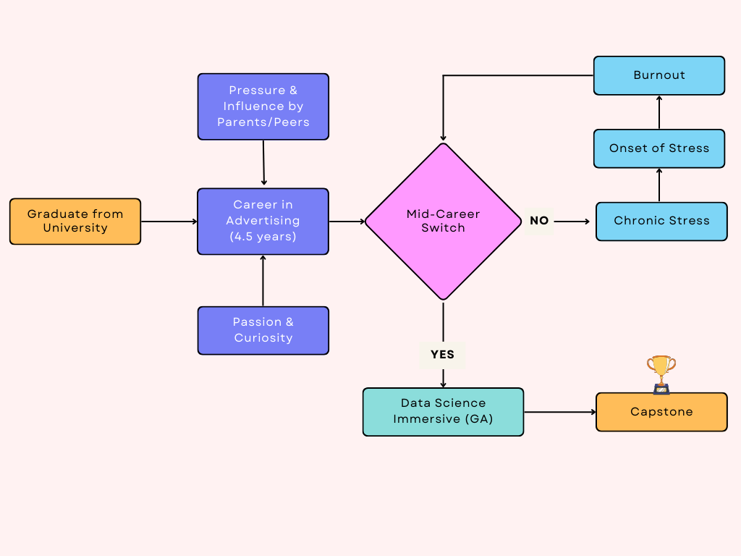
MY DSI JOURNEY
Notes:
Data Science is:
Pipedream
Something cool that nerds talk about. Machine Learning, AI and all that shenanigans
YOU may be asking, why am I talking about my career journey. Well, this is why i’d like to bring you something close to my heart. Having been someone who struggled with mental health.
WELCOME. My name is Amoz, and Welcome to the 2024 Mental Health with AI Seminar (hosted by MOH), i represent the Data & Research Team from the MOH
YOU - Mental Professional (Clinicians/Therapist/Counsellors)
1 qtn - do you guys struggle with Mental Health too?
well, today I present to you an initiative (still in beta stage), that might possibly be of interest to you

Slide 2



FeelFlow AI
Decoding Emotions, Advancing Patient Support
Capstone Presentation - DSI-SG-42
14th May 2024
Amoz Kuang

Slide 3

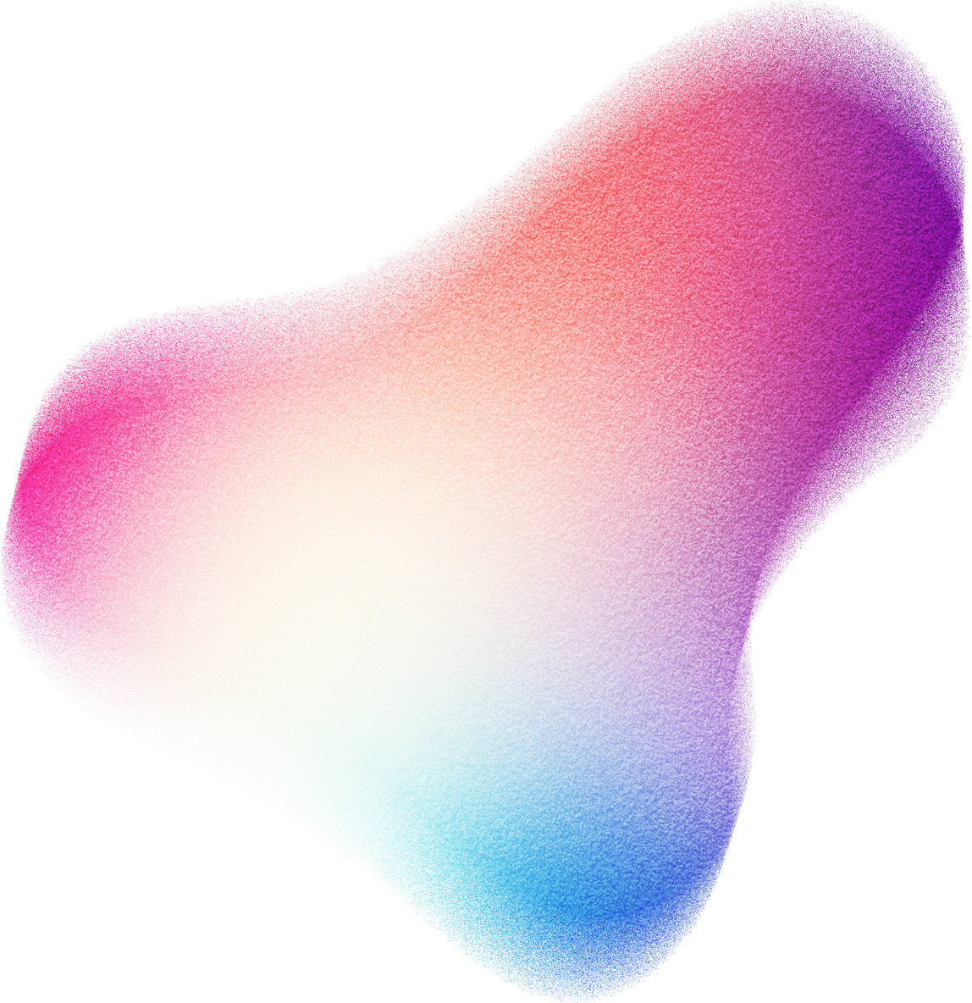
01 - Introduction
02 - Context + Problem Statement
03 - Methodology
04 - Insights
05 - Predictions
06 - Conclusion
07 - Demo
AGENDA
Notes:
Here are what we’ll go through today

Slide 4
01 INTRODUCTION

Slide 5
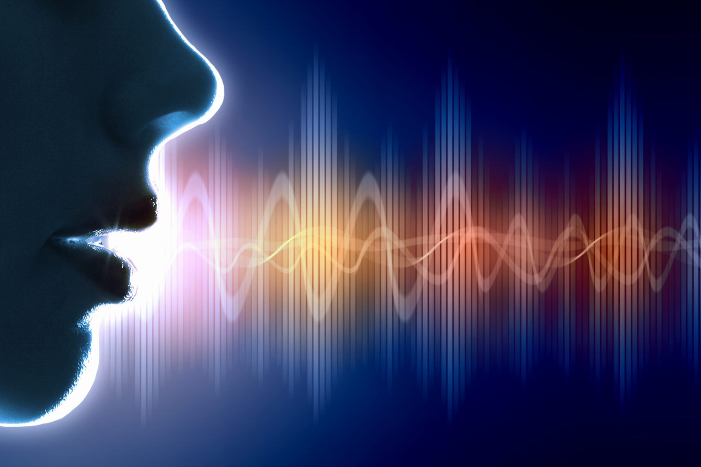
SPEECH EMOTION RECOGNITION (SER)?
Speech Emotion Recognition (SER) in therapy refers to the use of technology to analyse and identify emotional states from a person's audial characteristics during speech. With the help of machine learning, this technology processes verbal cues such as tone, pitch, tempo, and volume can help to classify emotions such as anger, disgust, fear, happiness, neutral or sadness.
Notes:
[FOR @AMOZ - when describing this slide, do different intonations]
For instance, if I talk like that (exaggerated for example)
(Happy) I am very depressed, I’m tired
(Sad) I like the Data Science Immersive course, it has benefited me greatly
We as humans MAY capture decipher, but it’s not a given. With the leverage of Machine Learning and Data, to help us with more accurate prediction

Slide 6
02 CONTEXT + PROBLEM STATEMENT

Slide 7
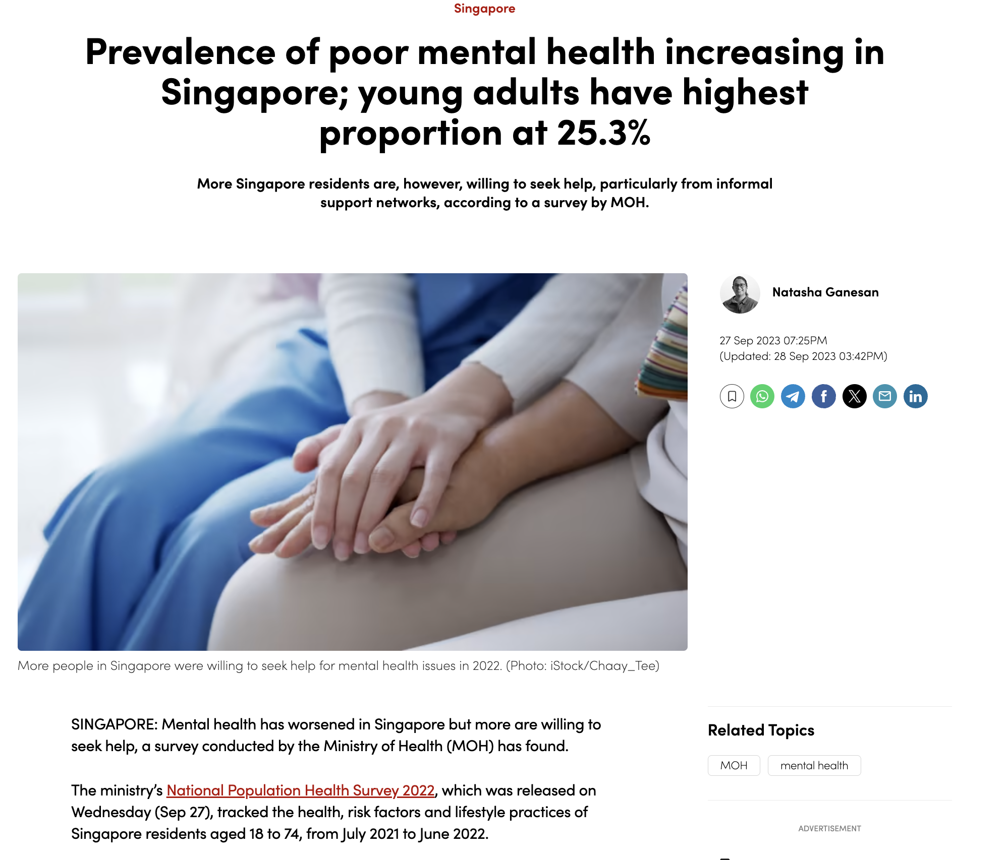
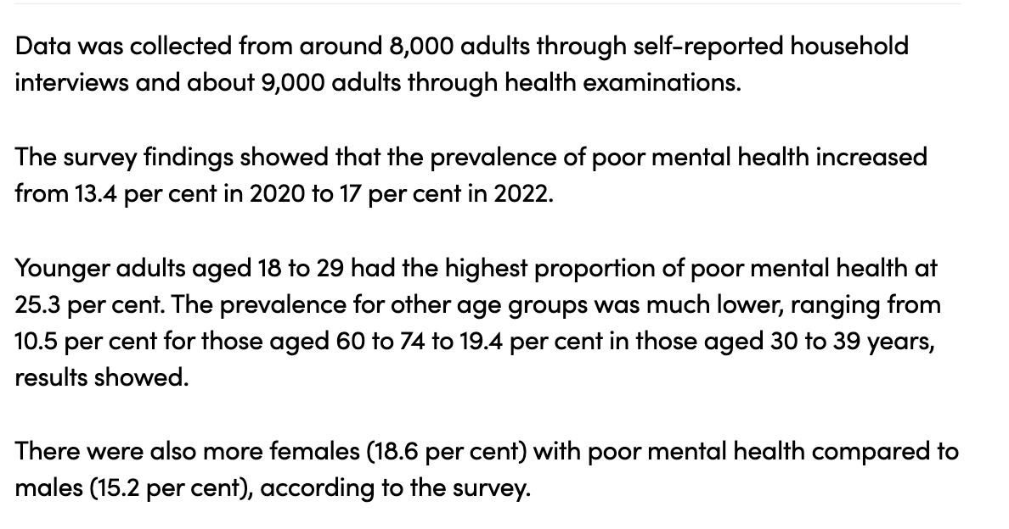
CONTEXT
Sources: CNA, 2020, CNA, 2023
Notes:
Younger Adults 18-29 years are faced with mental health through school, work, family, relationship issues.

Slide 8
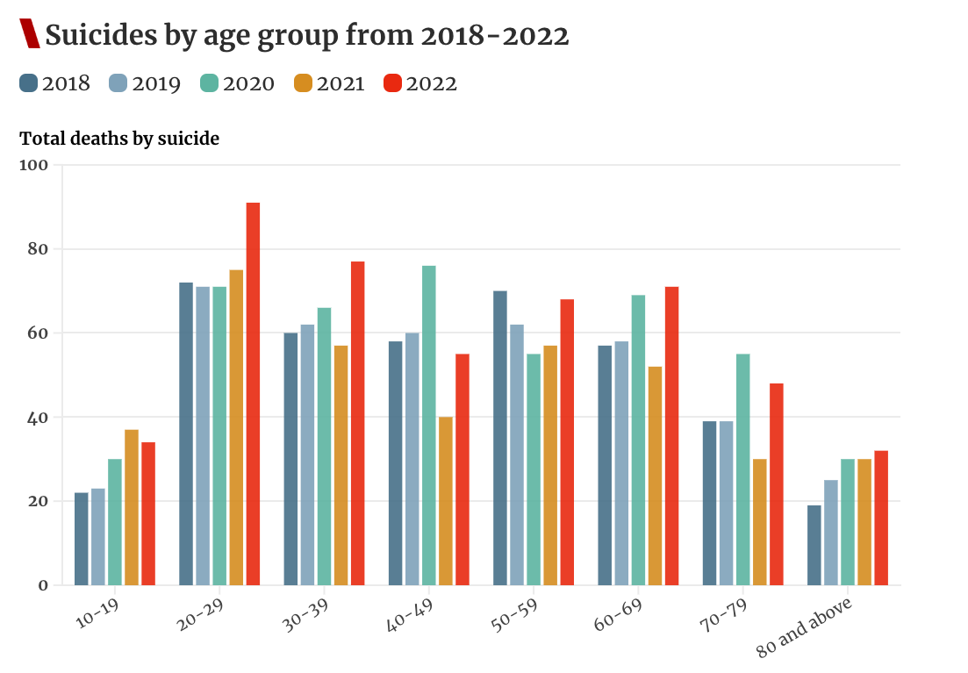
EFFECTS OF MENTAL HEALTH
Sources: CNA, 2023
Notes:
When intervention does not happen or proper support is not rendered, one of the saddening and common ultimatums of depression ends with suicide. Now i’m not trivialising, but you can see how suicide rates are not improving YOY
What’s worrying is the increasing number, amongst the younger age group <39 years old and below.

Slide 9

"I felt ignored, like (school counselling is hopeless) even if I bring up my problems,"
"Jane* opened up to her secondary school counsellor about the cold wars and troubles she was having with some close friends, she was told that ‘life’s like that’."
Sources: CNA, 2021
Notes:
Yet, people are constantly faced with horrible experiences with counsellling support, even though they need it the most

Slide 10
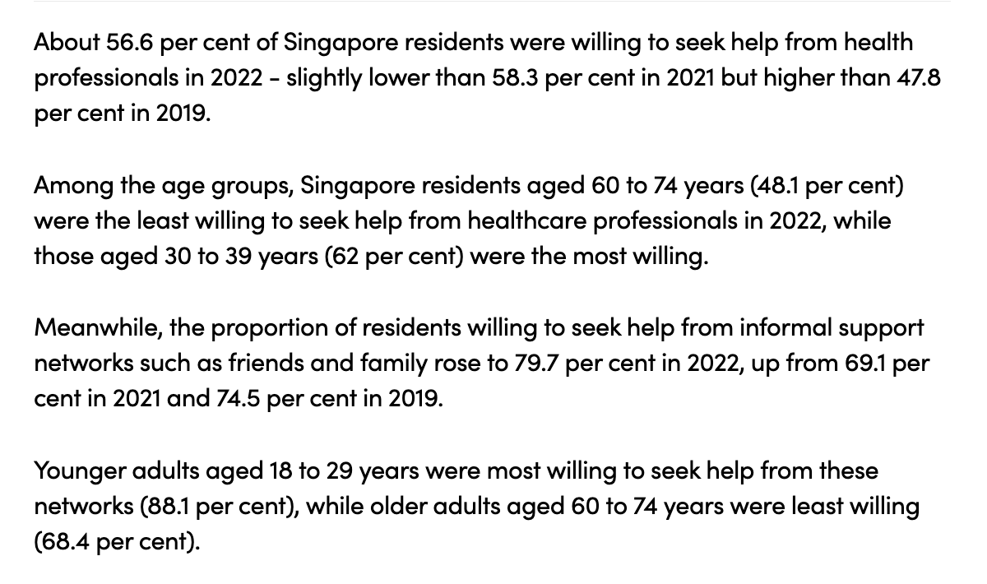
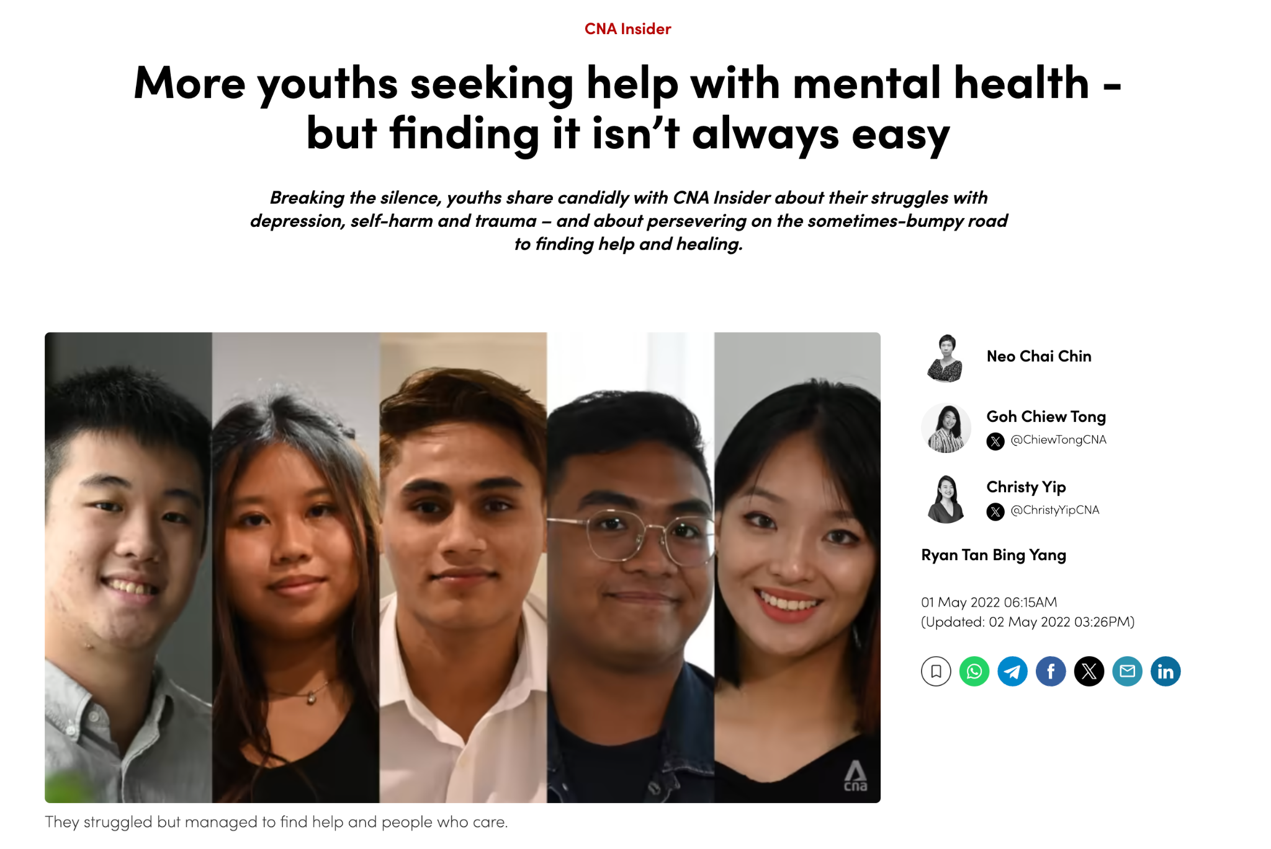
THERE IS STILL DEMAND…
"The earliest appointment they could give me was two months later. But I felt I needed help now."
Sources: CNA, 2022, CNA, 2023
Notes:
Even though we hear cases like these, most youngsters are still willing to seek help to treat their mental health.
We understand, it’s not easy to be on the end where you feel responsible to support someone. The job is not easy, but..what if i tell you that we can explore an option today?

Slide 11
PROBLEM STATEMENT
"Where discerning people’s emotion can sometimes be an unnerving guessing game, how can clinicians use Speech Emotion Recognition technology to accurately assess patients' emotional well-being, thereby improving diagnosis and treatment outcomes?"

Slide 12
Accurate Prediction of the Emotional state through the Patients’ speech
Beneficiaries
YOU
YOUR Company
THE ‘FEELFLOW’
WAY
(OBJECTIVE)
Beneficiaries
YOUR Patients
YOU
YOUR Company
Better Diagnosis & Treatment Rendered
Notes:
When you benefit, we benefit too.

Slide 13


PERSONA
Thomas Chew, 55,
Senior Counsellor @ Samaritans of Singapore
Attitudes & Behaviours
Recent portfolio focus on GenZ and millennials, facing issues like work/school/relationship-related burnout, anxiety, depression.
Pain points
Does not have a kid. Has been out of touch with youth lingo, behaviours, knacks, and feels like it might be hard to reach his audience.
Scenario
He heard that a teen that he recently counseled has displayed signs of depression, although during the sessions he seem perfectly normal
Motivation
Embraces technology as a hobby, keeping up with the latest tech gadgets and news
Is passionate about AI and tech in the MediTech space

Slide 14
03 METHODOLOGY

Slide 15
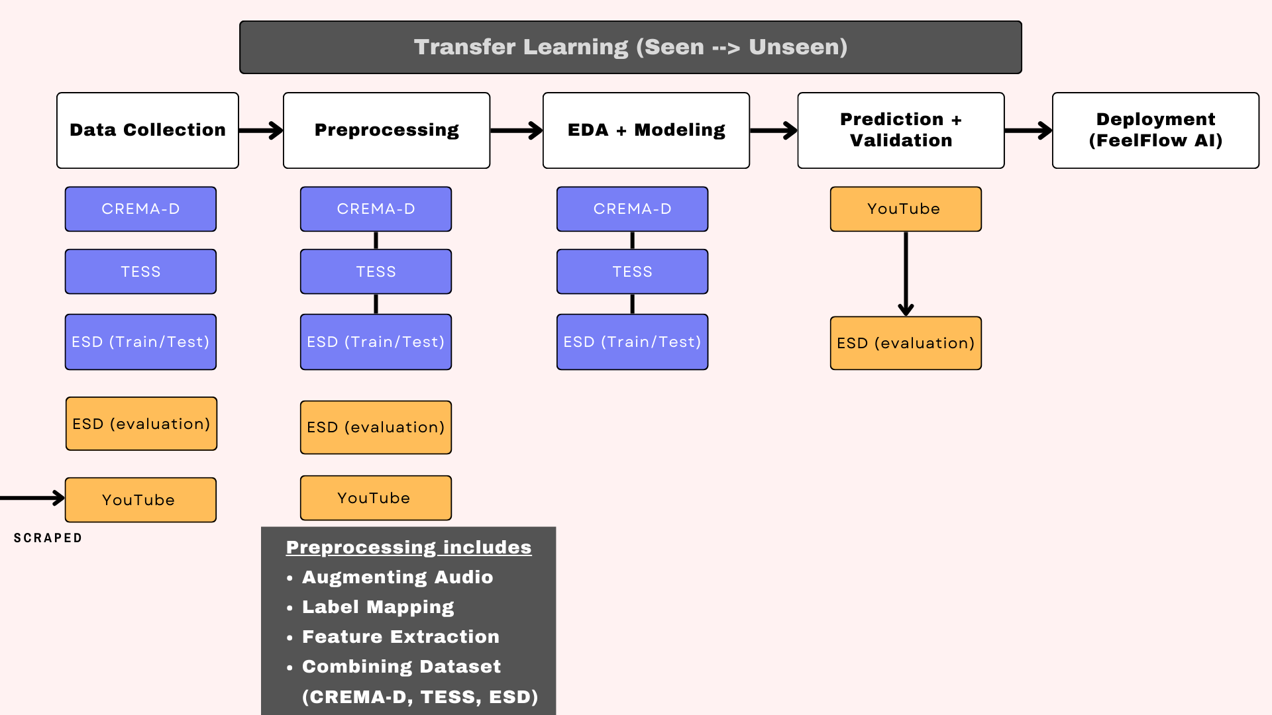

Slide 16



ABOUT THE DATA (SEEN)
CREMA-D
Emotion Speech Dataset (ESD)
Data includes 350 parallel utterances:
10 native Mandarin speakers, 10 English speakers
5 emotions
(neutral, happy, angry, sad, and surprised)
Data is split into training, test, and evaluation
Crowd-sourced Emotional Multimodal Actors Dataset (CREMA-D)
Data includes:
7,442 audio files
91 actors
6 emotions
(neutral, happy, angry, sad, disgust, and fear)
Toronto Emotion Speech Set (TESS)
Data includes 200 target words:
2800 audio files
7 emotions
(neutral, happy, angry, sad, disgust, fear, and pleasant surprise)

Slide 17

ABOUT THE DATA (UNSEEN)
Emotion Speech Dataset (ESD)
Data includes 350 parallel utterances:
10 native Mandarin speakers, 10 English speakers
5 emotions
(neutral, happy, angry, sad, and surprised)
Data is split into training, test, and evaluation
YouTube Data
(scraped and unlabeled from 8 different sources - Podcasts, Docuseries, Documentaries etc.)
Links found in Notebook

Slide 18
04 INSIGHTS

Slide 19
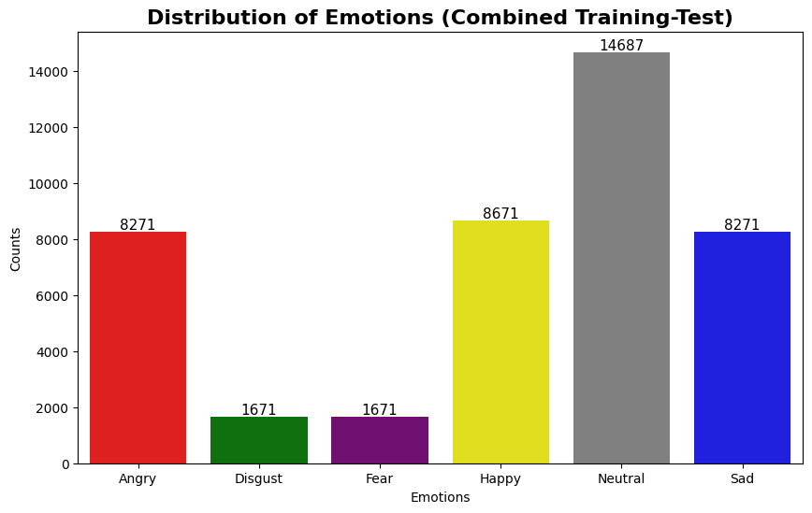
‘Disgust’ and ‘Fear’ are the minority class in the training-test dataset
Rationale:
‘Surprise’ emotion in ESD - mapped as ‘Neutral’ (~6.6k)

Slide 20
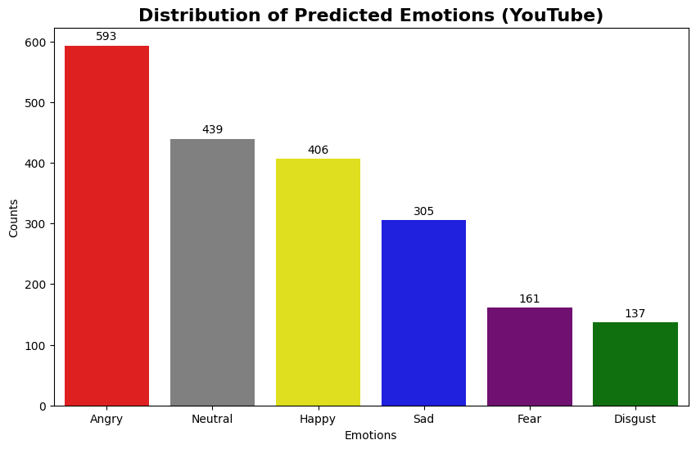
Expected to have ‘Fear’ and ‘Disgust’ as the least distributed predicted emotions due to the imbalance trained and tested dataset - even after more class weights importance
Overall, more balanced prediction than the train-test data
Further validation is required from ESD (eval) dataset

Slide 21
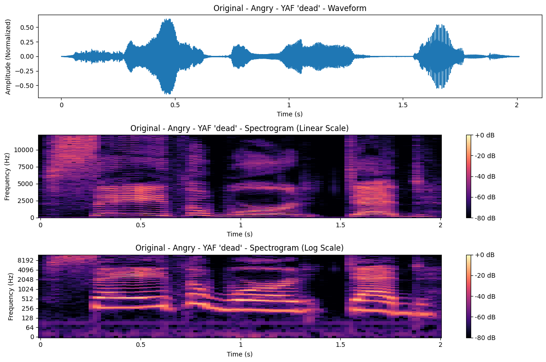
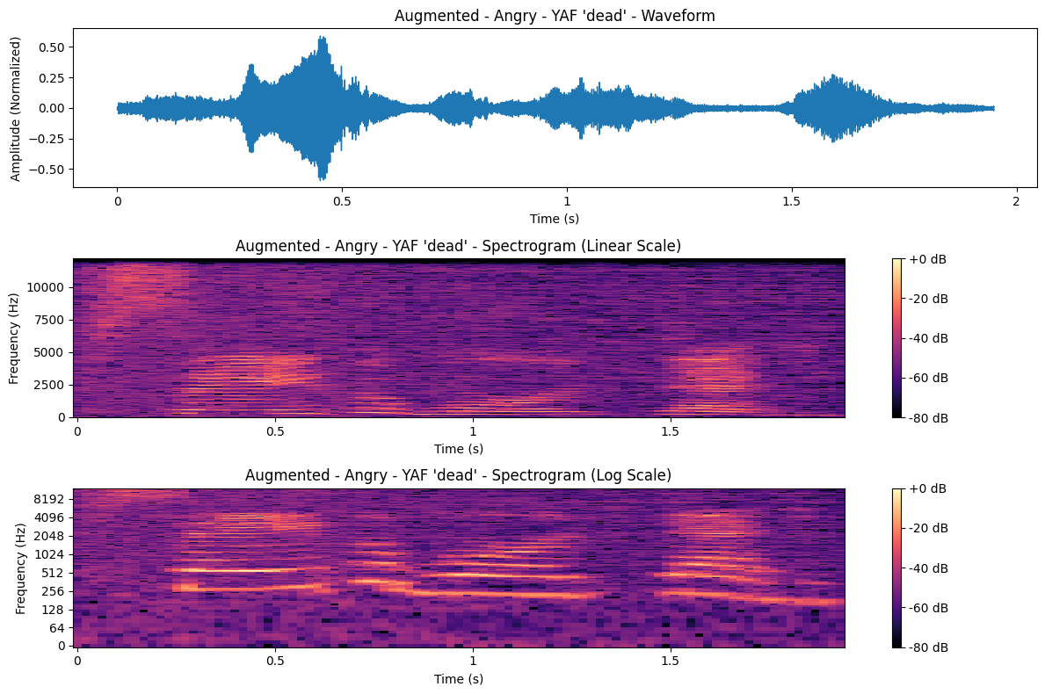
EFFECTS OF AUGMENTATION - ANGRY (NOISE ADDITION)
Notes:
We’ll focus on negative emotions - anger, disgust, fear, sad
In general, the augmentation normalizes the effect of normal-high fluctuation. Simulate noisy environment (taking the call on-the-go). more obvious before the speech starts

Slide 22
EFFECTS OF AUGMENTATION - ANGRY (TIME SHIFT)
Notes:
introduce slight variance in early start to speech - reason is bcos people might start to speak earlier. helps to recognise emotions quicker

Slide 23
EFFECTS OF AUGMENTATION - ANGRY (PITCH SHIFTING)
Notes:
It’s good because people dont usually shout during therapy?

Slide 24
LINEAR SPECTROGRAM - ANGRY
“Blendedness” is referred to as smoothening of the pitch
This makes the model less “sensitive” to spikes in volume and/or pitch especially when someone is angry

Slide 25
LINEAR SPECTROGRAM - ANGRY
Padding:
Consistency in duration of each audio data
Model Prep - especially for CNN + RNN-type models
Allows for real-time processing (buffering the audio stream)
Notes:
OR ELSE MODEL

Slide 26
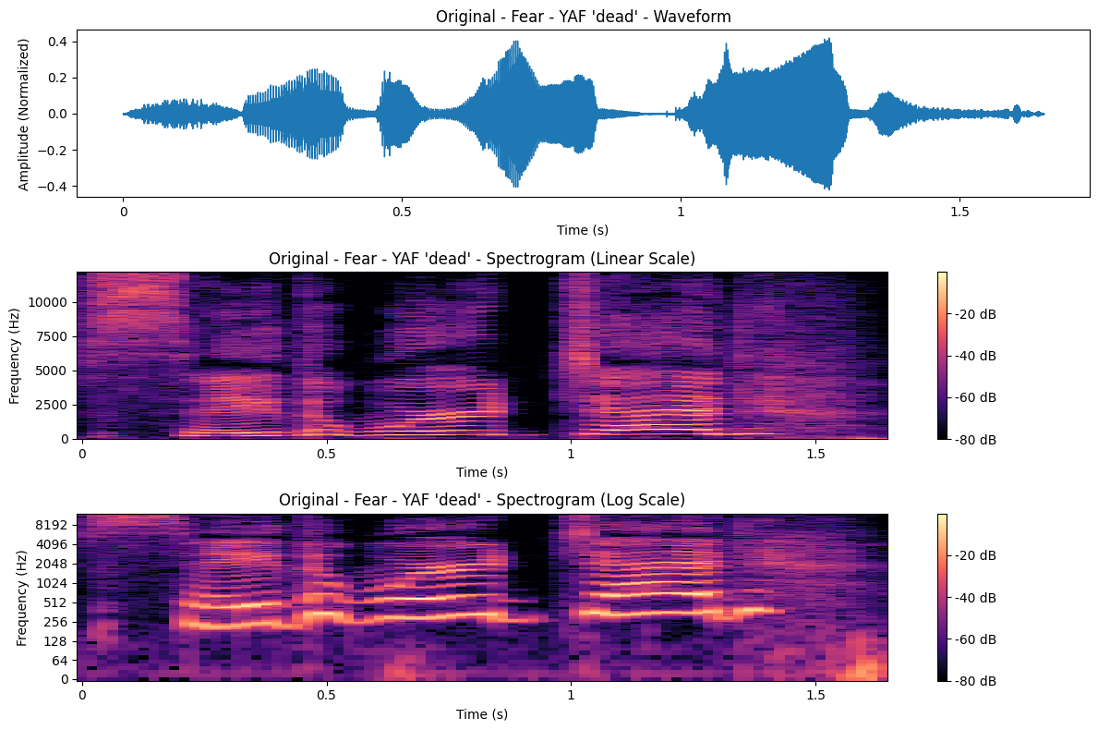
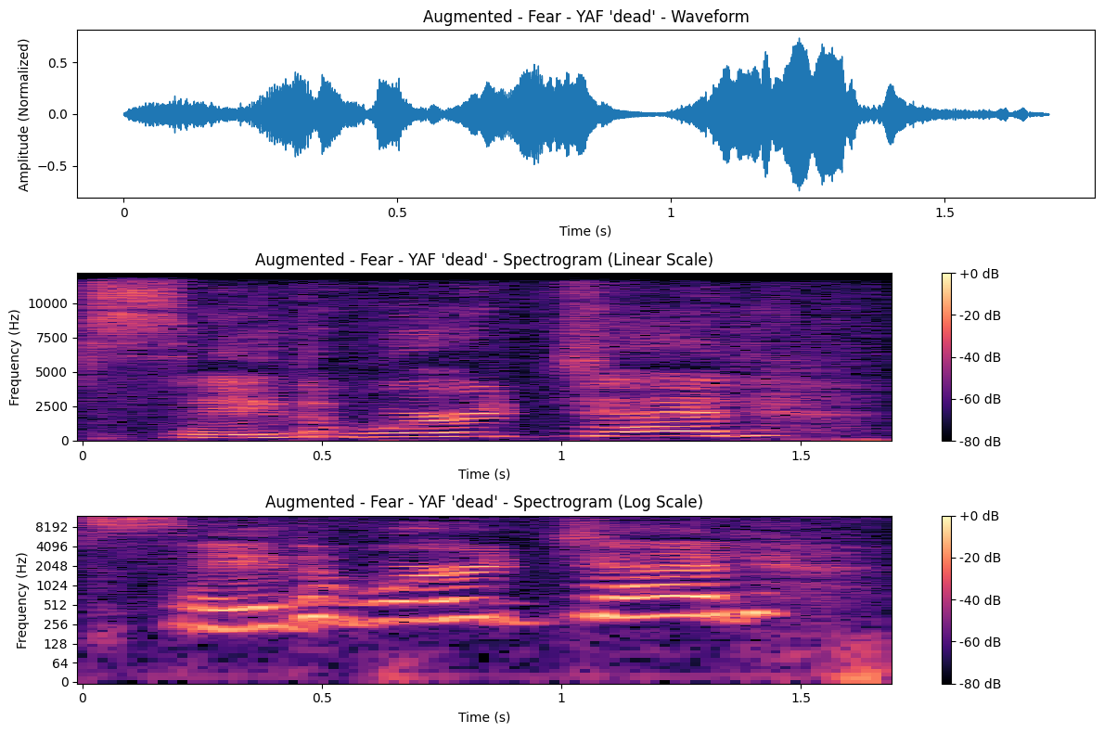
EFFECTS OF AUGMENTATION - FEAR (NOISE ADDITION)

Slide 27
EFFECTS OF AUGMENTATION - FEAR (TIME SHIFT/STRETCH)

Slide 28
EFFECTS OF AUGMENTATION - FEAR (PITCH SHIFT)

Slide 29
LINEAR SPECTROGRAM - FEAR
Augmentation here has little to no effect as compared to ‘Angry’ and ‘Disgust’ emotions.

Slide 30
05 PREDICTIONS

Slide 31
MODEL EVALUATION
Model Name | Train Accuracy | Validation Accuracy | Processing Time (sec)
Random Forest Classifier | 1.0000 | 0.6167 | 33
Multilayer Perceptron Classifier | 0.7019 | 0.6465 | 4038
LSTM + 1D CNN | 0.5832 | 0.5412 | 1260
LSTM + 2D CNN | 0.4007 | 0.4159 | 46
(Modified) WaveNet | 0.6539 | 0.6168 | 1016
Analysis
WaveNet as the champion model, no overfit, nor underfit. Generalises well.
Allows for training of real-time data - which the study aims to explore in the next Phase(s)

Slide 32
DIFFERENCE IN WAVENET MODELS USED
Parameters / Models | Standard WaveNet | Modified WaveNet
Dilated Convolution | Different Temporal Resolution (1, 2, 4, 8 etc.) | [1, 2, 4, 8, 16, 32] Maximum Expansion for broader audio contexts
Skip Connections | SAME
Activation & Normalisation | Gated Activation (tanh + sigmoid) | ReLU (more simple for quicker training time)
Output Processing | ReLU > 1x1 Con Layer > ReLU > 1x1 Con Layer | Skip Connection > ReLU > 1x1 Con Layer
Loss Functions & Optimisation | Softmax + Logits | Sparse Categorical Crossentropy (with Adam optimiser)
Training Configuration | Depends on application, not explicit | Dropout (0.2), Early Stopping (=5) with Custom Class weights
Notes:
The Rectified Linear Unit (ReLU), also known as the rectifier or ramp function. Changes negative numbers to zero. To ensure non-linearity
avoid the problem of "vanishing gradients". helps to retain and account for all info, by passing the first few layers to the deeper ones (skipping the ones in between)
softmax+logits simply means that the function operates on the unscaled output of earlier layers and that the relative scale to understand the units is linear. It means, in particular, the sum of the inputs may not equal 1, that the values are not probabilities
Early Stopping at =5, allows for no overfitting

Slide 33
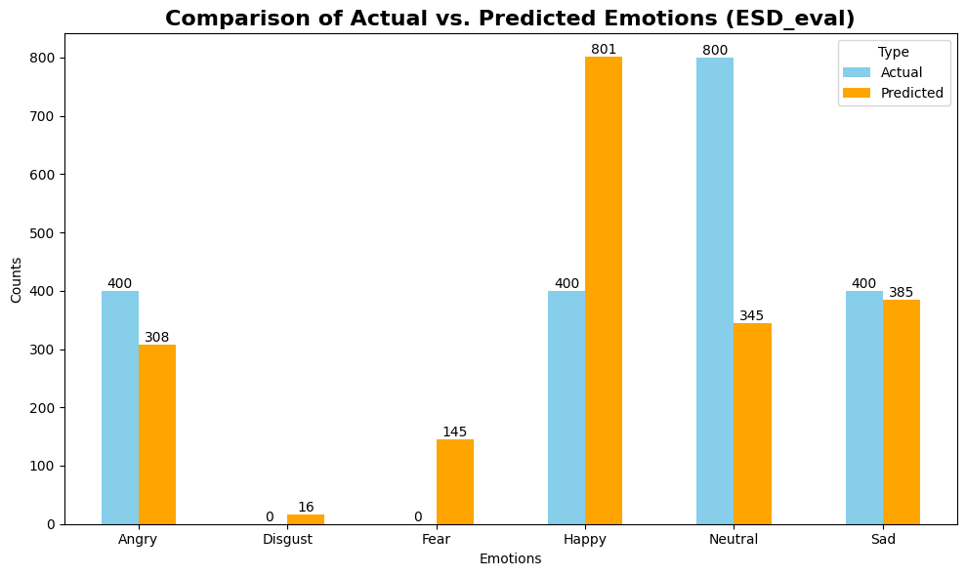
VALIDATION (ESD_EVAL)
Negative Emotions
Overprediction on ‘Disgust’ and ‘Fear’, which may unnecessarily trigger attention required.
Slight underprediction for ‘Angry’ and ‘Sad’, may require more training of data, and clinicians to administer personal discernment
‘Happy’ - overprediction, which may delivered false reassurance to the clinicians.
Notes:
ESD_eval has prelabels which gives the “single source of truth” and serves as a good measure for validating the model accuracy

Slide 34
06 CONCLUSION

Slide 35
COST BENEFIT ANALYSIS (MICRO)
Cost
No monetary costs to him
Benefit
Sessions per Day: ~ 5 sessions a day.
Daily Savings: 20% time savings = 1 extra session/day (+$150-200)
Annual Savings: Assuming 200 working days/year, the additional revenue or value from enhanced efficiency could range from $30,000 to $40,000 annually.
Thomas Chew
Notes:
Time = $ doesnt mean expenditure, but also means savings and potential earnings tooo

Slide 36
COST BENEFIT ANALYSIS (MICRO)
Cost
No monetary costs to him
Benefit
Sessions per Day: ~ 5 sessions a day.
Daily Savings: 20% time savings = 1 extra session/day (+$150-200)
Annual Savings: Assuming 200 working days/year, the additional revenue or value from enhanced efficiency could range from $30,000 to $40,000 annually.
Thomas Chew
Cost
$150-$200/session
Benefit
Estimated Treatment Duration: 20 sessions/year
Savings: 10% of total cost, equaling $300 - $400 per treatment cycle.
PATIENT #A
Notes:
Time = $ doesnt mean expenditure, but also means savings and potential earnings tooo

Slide 37
COST BENEFIT ANALYSIS (MACRO)
Cost
Implementation costs: ≥ $50k
Cost of Maintenance + Analysing: $10-50k
Benefit
Average Monthly Patient Load: 300 patients.
Additional Patients: 30 patients (10%)
Increased Revenue: 30 patients x $175 (average session cost) x 20 sessions = $105k
THERAPY CLINIC(S)
Sources:
CNA, 2024, MOF, 2023
Notes:
TIme is $

Slide 38

COST BENEFIT ANALYSIS (MACRO)
Cost
Implementation costs: ≥ $50k
Cost of Maintenance + Analysing: $10-50k
Benefit
Average Monthly Patient Load: 300 patients.
Additional Patients: 30 patients (10%)
Increased Revenue: 30 patients x $175 (average session cost) x 20 sessions = $105k
THERAPY CLINIC(S)
Cost
~$435 million (out of $16.68 billion budget)
Benefit
Assuming 1% savings of allocated $435 million budget to mental health (subsidies etc.)
1% x $16.68 billion = $4.4 million
Sources:
CNA, 2024, MOF, 2023
Notes:
TIme is $

Slide 39
SUMMARY
WaveNet model classified 6 Emotions accurately 6 out of 10 times (0.65)
Allows lesser reliance on clinician’s self-discernment to assess patients’ moods/emotional state

Slide 40
SUMMARY
WaveNet model classified 6 Emotions accurately 6 out of 10 times (0.65)
Allows lesser reliance on clinician’s self-discernment to assess patients’ moods/emotional state
Proof-of-Concept (FeelFlow 1.0) worked
Recognition of emotions
Transcribing of words spoken

Slide 41

PROJECT SCOPE (MULTI-PHASED APPROACH)
WE’RE HERE!!!
FeelFlow AI 1.0
[**CAPSTONE**]
Transfer Learning to the YouTube dataset
(which emulates a real Therapy setting)
Classify audio into 6 emotional labels using the Modified WaveNet
Using OpenAI’s Whisper package for Application
FeelFlow AI 2.0
[**BEYOND CAPSTONE **]
Transcription allows for us to conduct sentiment analysis to build a more robust model that classifies emotions in not just through audible speech, but also in the nuances meaning of the words, sentences verbalised.
[Duration: 2-3 months]
FeelFlow AI 3.0
[**BEYOND CAPSTONE **]
Incorporate the use of facial recognition and body language. Mood and emotions are not just expressed in speech but also through the physical body as well.
[Duration: 3-4 months]

Slide 42


Limitations of Study | Recommendations for Future
Data Collection Culturally Nuanced (Other languages, beyond English) Generational Nuanced (Lingos used by GenZs) Does not account for accent (Singapore = multicultural?) | Collaborate with local Tertiary Institutions to collect and integrate data. [Note: Patient consent/PDPA has to be sought at point of collection]
Notes:
False Negative refers to an instance where the model incorrectly predicts a non-negative emotion (like neutral or happy) when the true emotion is actually one of the negative ones (sad, angry, fear, disgust)

Slide 43
Limitations of Study | Recommendations for Future
Data Collection Culturally Nuanced (Other languages, beyond English) Generational Nuanced (Lingos used by GenZs) Does not account for accent (Singapore = multicultural?) | Collaborate with local Tertiary Institutions to collect and integrate data. [Note: Patient consent/PDPA has to be sought at point of collection]
Limited defined Emotional Labels related to Mental Health (Sad = Depressed?) | Redefine emotional labels, and consider a wider but definitive spectrum [Note: Be sure not to overlap emotions - e.g. Disappointment = Anger + Sadness]

Slide 44
Limitations of Study | Recommendations for Future
Data Collection Culturally Nuanced (Other languages, beyond English) Generational Nuanced (Lingos used by GenZs) Does not account for accent (Singapore = multicultural?) | Collaborate with local Tertiary Institutions to collect and integrate data. [Note: Patient consent/PDPA has to be sought at point of collection]
Limited defined Emotional Labels related to Mental Health (Sad = Depressed?) | Redefine emotional labels, and consider a wider but definitive spectrum [Note: Be sure not to overlap emotions - e.g. Disappointment = Anger + Sadness]
Voice might not be able to sense contextual cues or things like sarcasm, lying etc. | Incorporate other stimulus: Natural Language Processing - Semantics of Text (FeelFlow 2.0) Facial Recognition (FeelFlow 3.0) [calculated by Emotion Detection Rate] Collaboration with AI SG - Speech Labs (already trained on local accent and speech semantics)
Notes:
False Negative refers to an instance where the model incorrectly predicts a non-negative emotion (like neutral or happy) when the true emotion is actually one of the negative ones (sad, angry, fear, disgust)

Slide 45
07 DEMO
Notes:
This is by no means an app that is the silver bullet to solving all your patients’ problems. And it is still in beta stage. My job here is to make you better at YOUR job. Nobody is stealing your job.

Slide 46


SCAN HERE

Slide 47
Thank You

Slide 48
APPENDIX

Slide 49
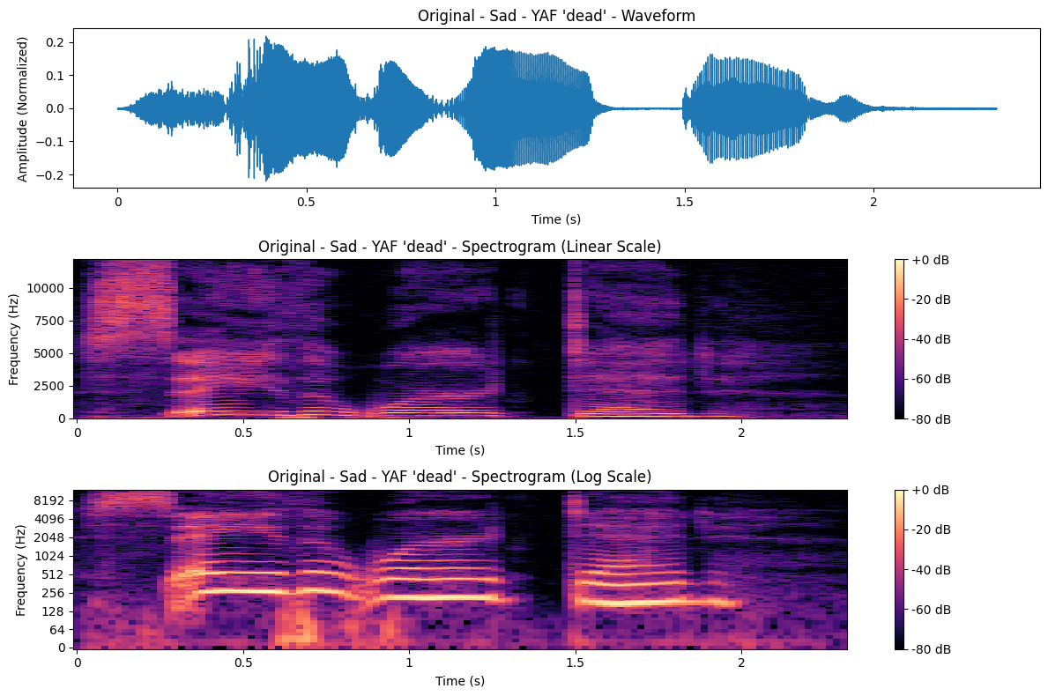
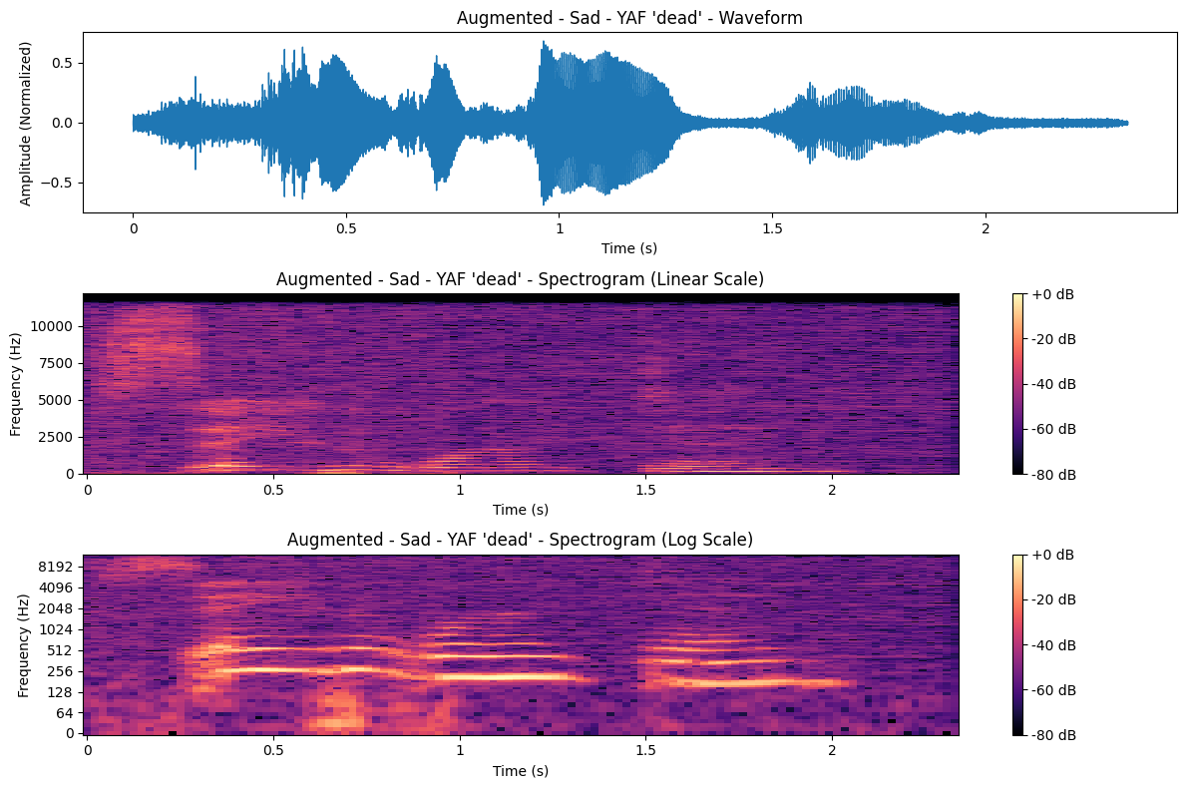
EFFECTS OF AUGMENTATION - SAD (NOISE ADDITION)

Slide 50
EFFECTS OF AUGMENTATION - SAD (TIME SHIFT/STRETCH)

Slide 51
EFFECTS OF AUGMENTATION - SAD (PITCH SHIFT)

Slide 52
LINEAR SPECTROGRAM - SAD
Sadness is usually monotonous and sombre in nature, hence high pitch is an anomaly.
Augmenting here has removed the unnecessary pitch

Slide 53
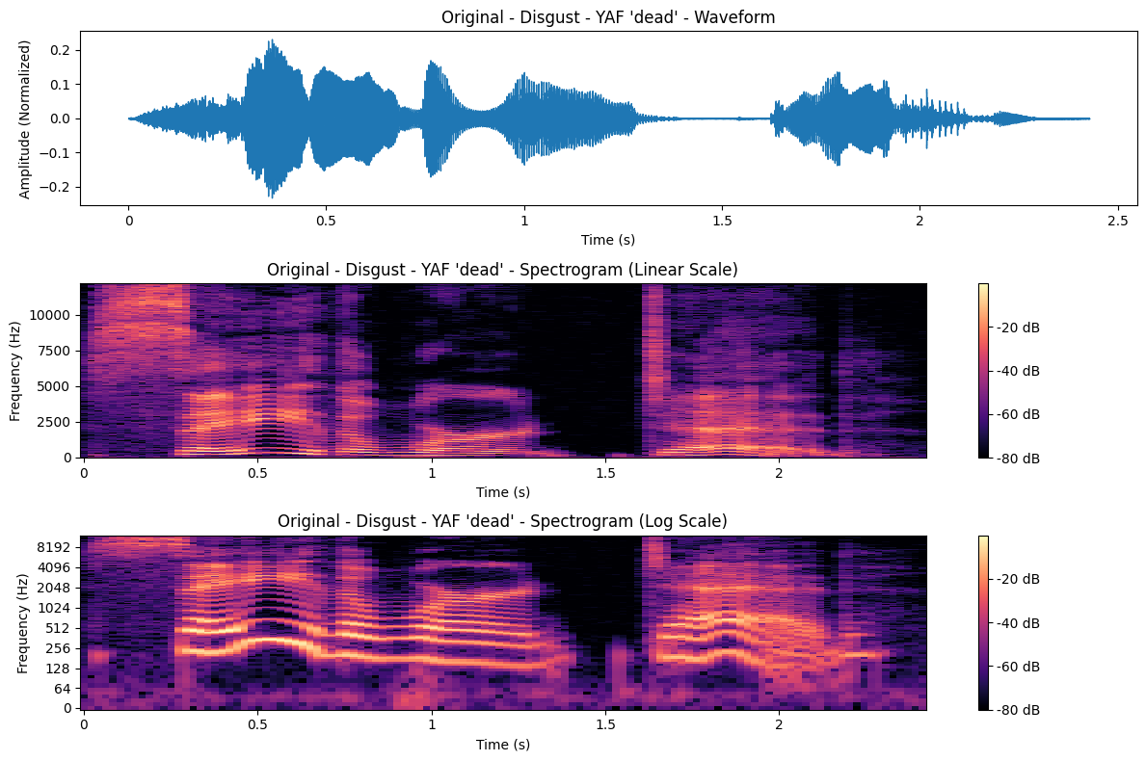
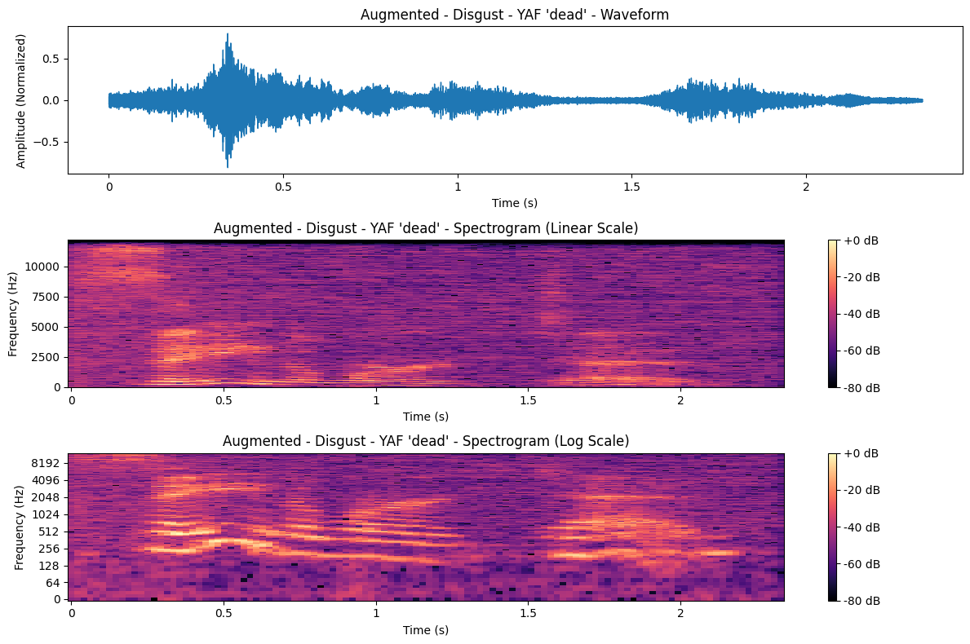
EFFECTS OF AUGMENTATION - DISGUST

Slide 54
LINEAR SPECTROGRAM - DISGUST
The intensity of the Augmentation effect here is similar to the one experienced in ‘Angry’

Slide 55
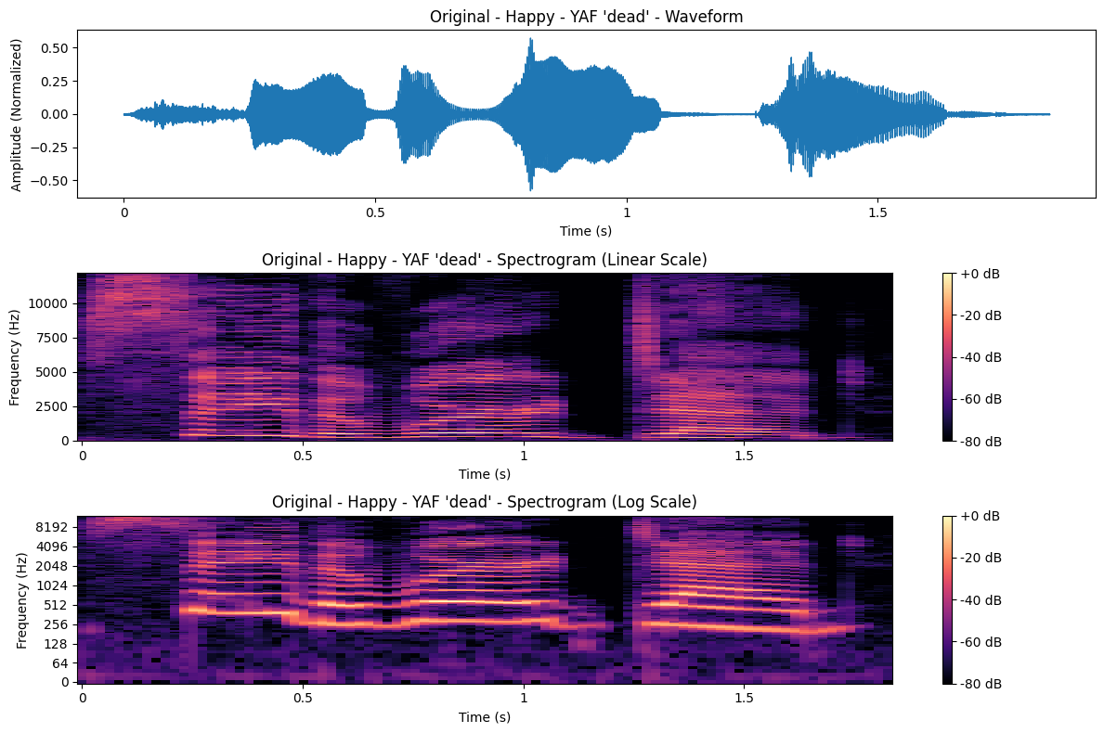
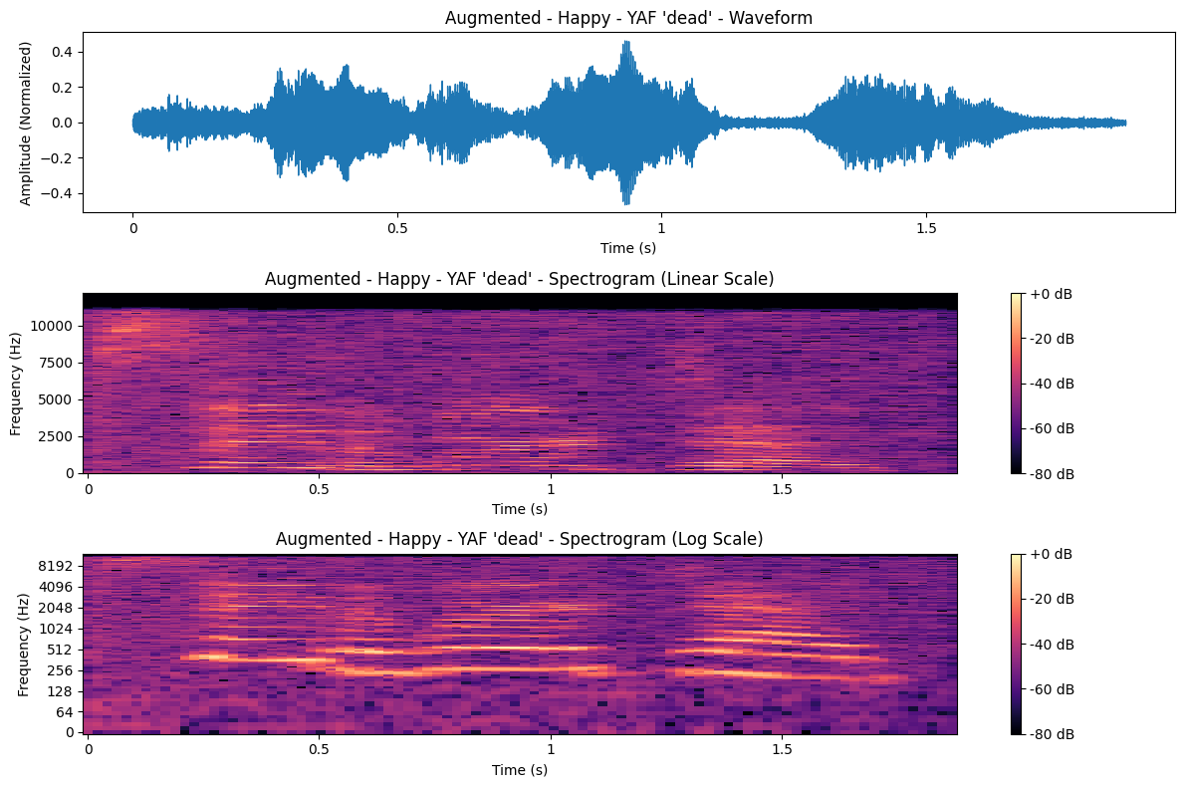
EFFECTS OF AUGMENTATION - HAPPY

Slide 56
LINEAR SPECTROGRAM - HAPPY

Slide 57
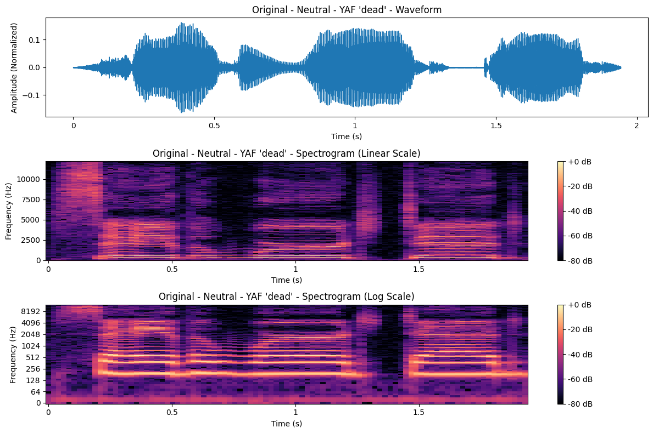
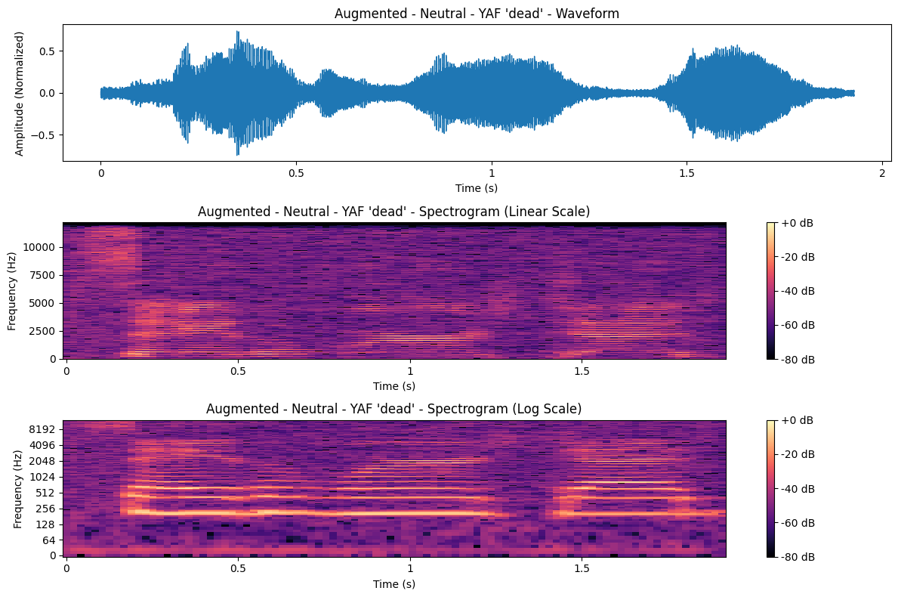
EFFECTS OF AUGMENTATION - NEUTRAL

Slide 58
LINEAR SPECTROGRAM - NEUTRAL

Slide 59
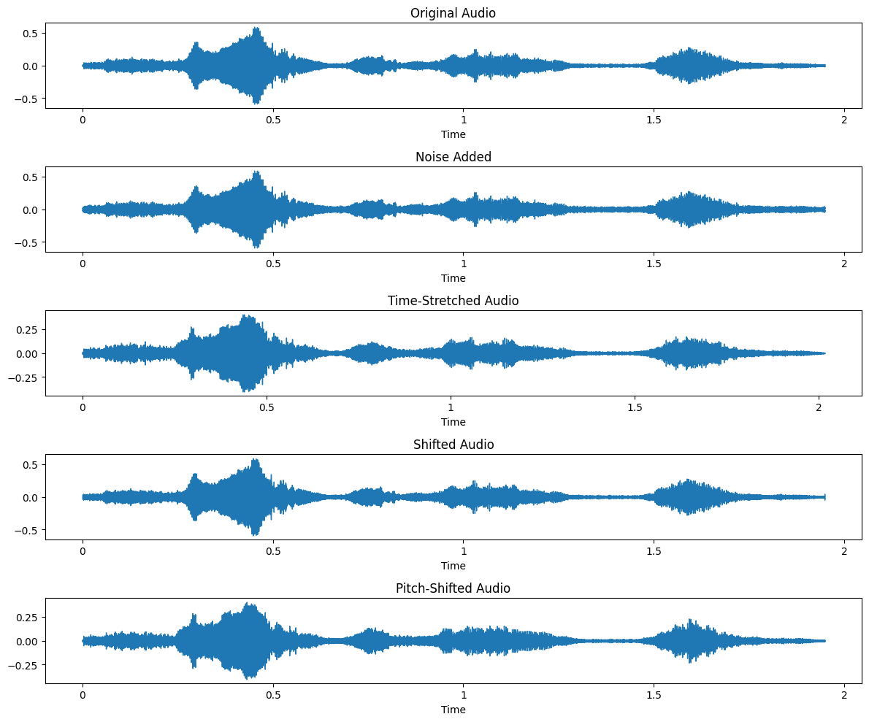
TYPES OF AUGMENTATION VS. ORIGINAL

Slide 60
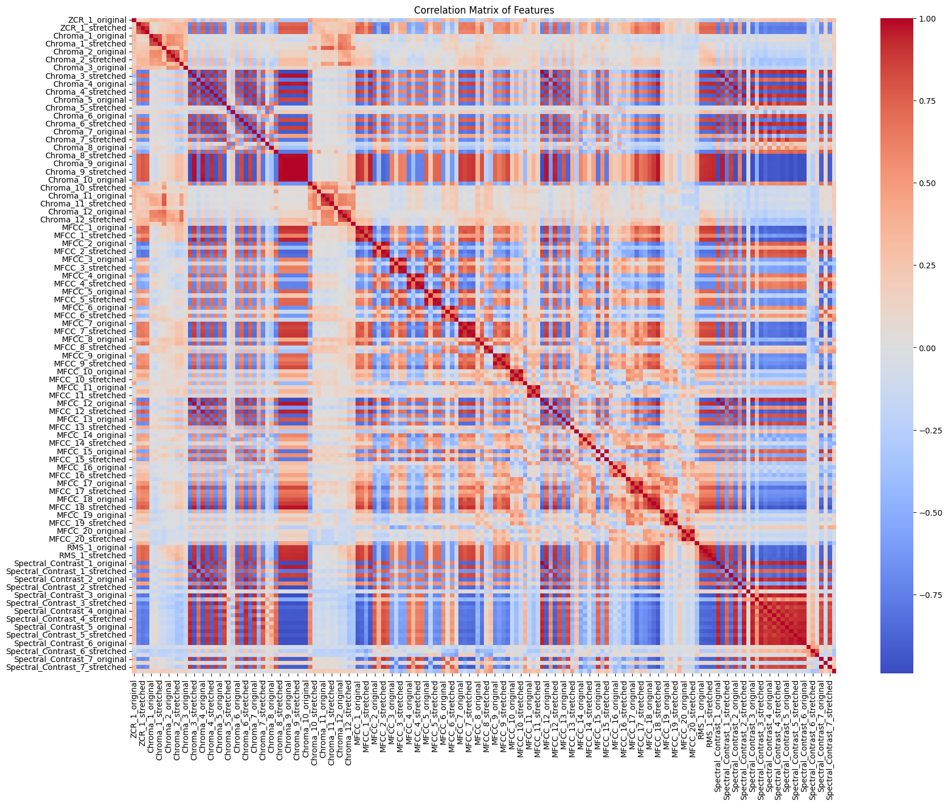

Slide 61
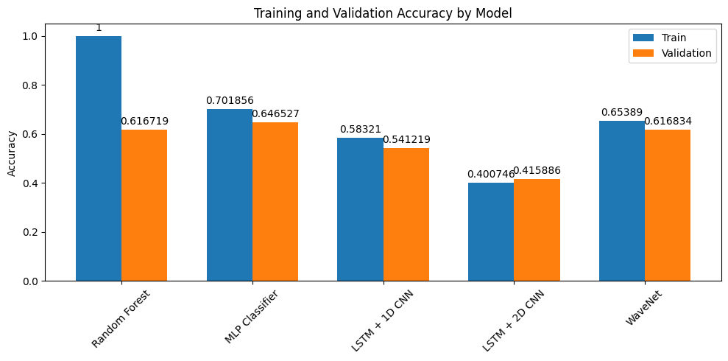
MODEL SCORE COMPARISON

Slide 62
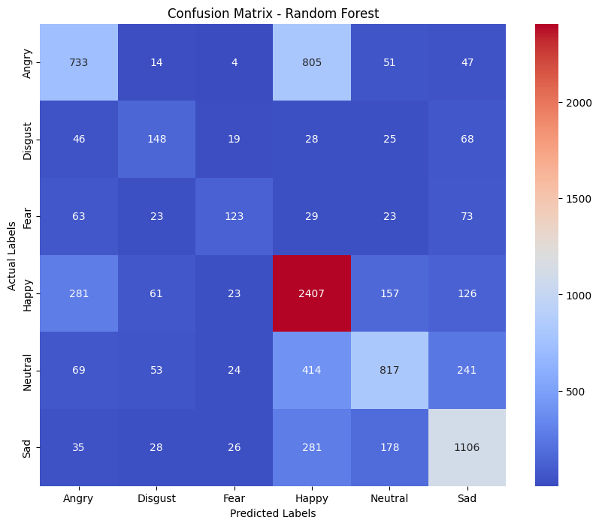
RANDOM FOREST CLASSIFIER

Slide 63
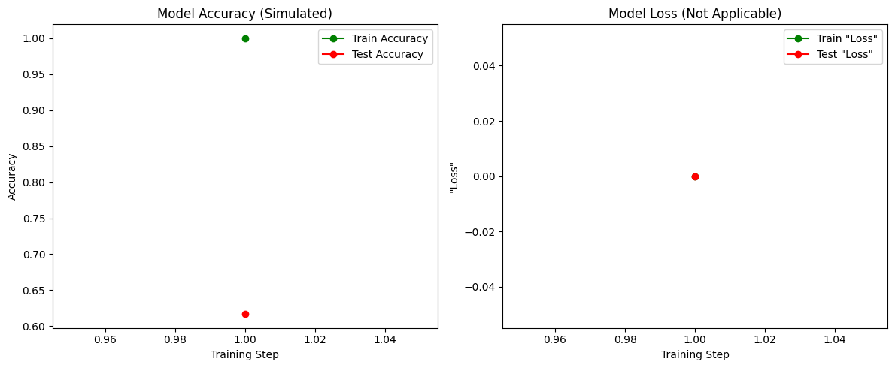
RANDOM FOREST CLASSIFIER
Note: Random Forest models cannot churn out Model Accuracy and Loss curve because they don’t run by layers

Slide 64
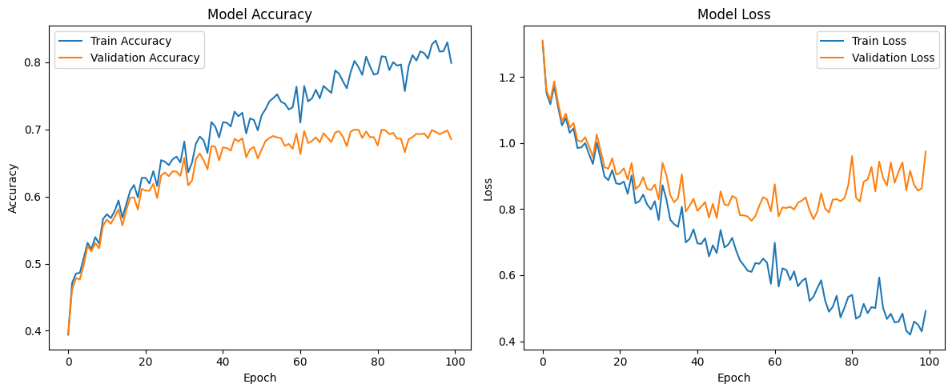
MLP CLASSIFIER

Slide 65
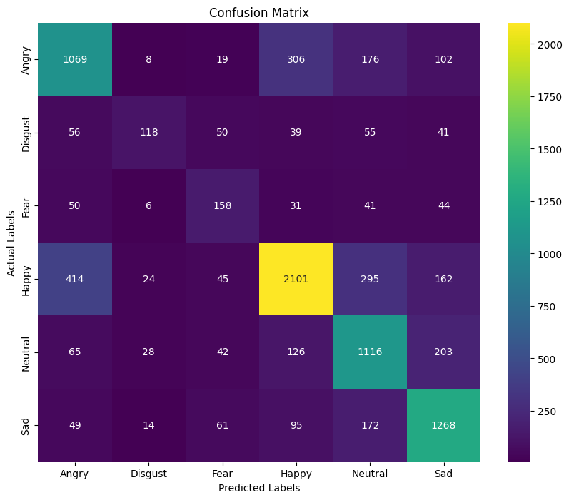
MLP CLASSIFIER

Slide 66
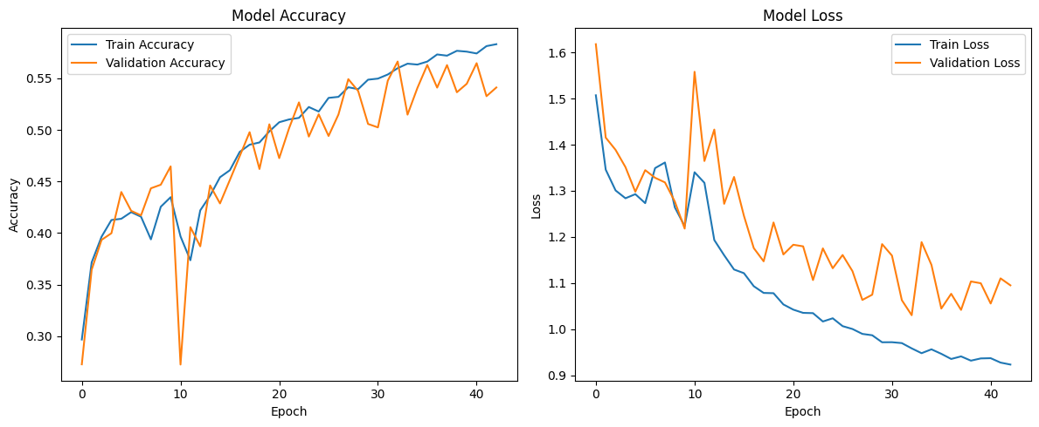
LSTM + 1D CNN

Slide 67
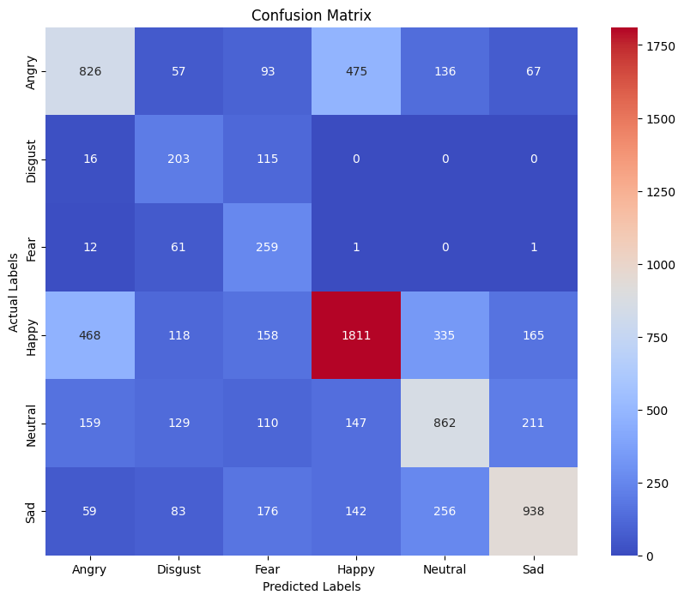
LSTM + 1D CNN

Slide 68
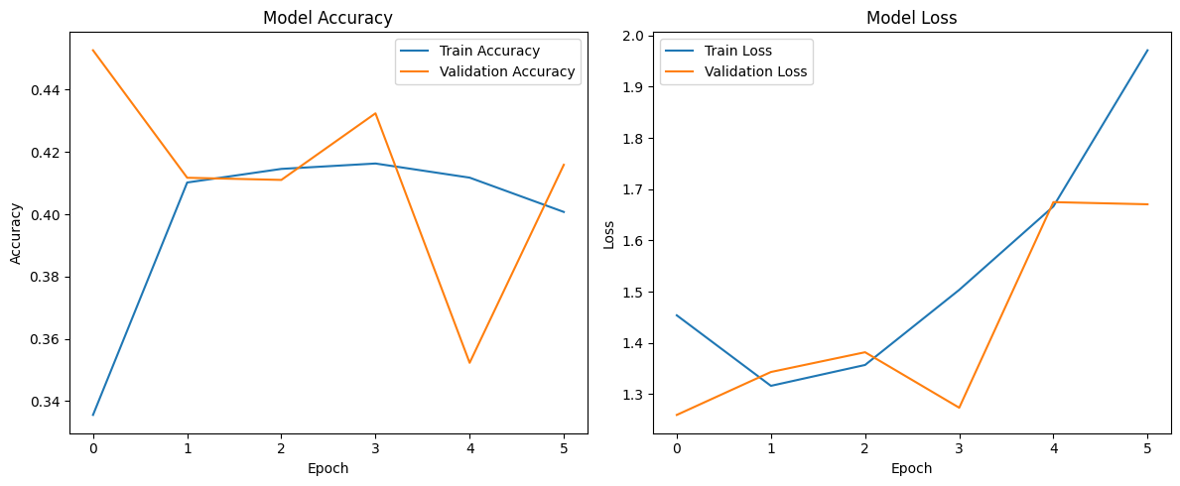
LSTM + 2D CNN

Slide 69
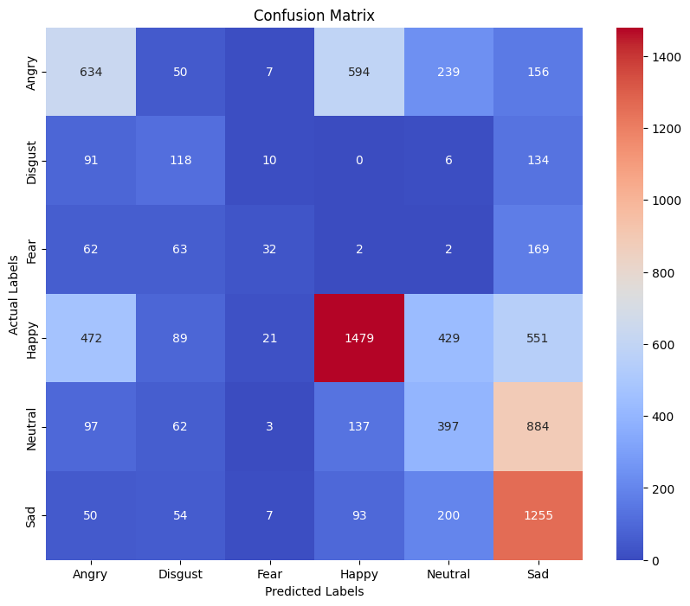
LSTM + 2D CNN

Slide 70
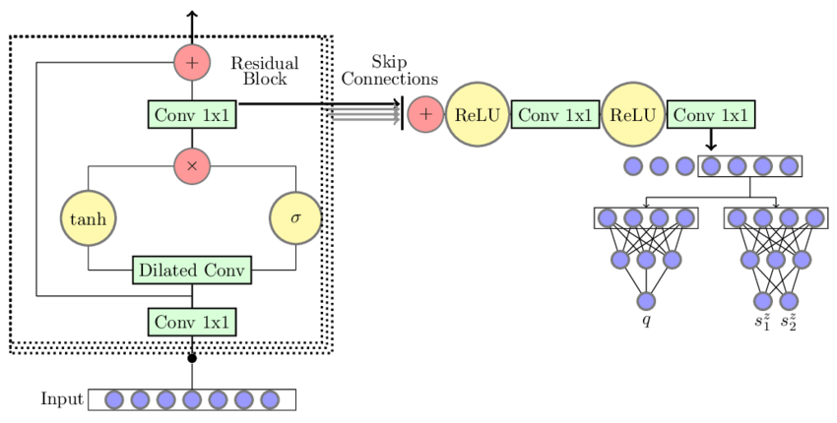
WAVENET - MODEL ARCHITECTURE (CHAMPION MODEL)

Slide 71
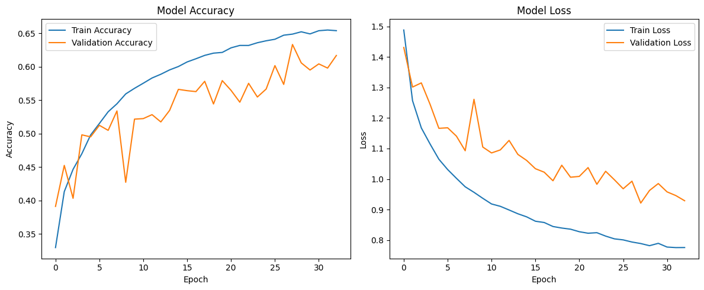
WAVENET - ACCURACY/LOSS (CHAMPION MODEL)

Slide 72
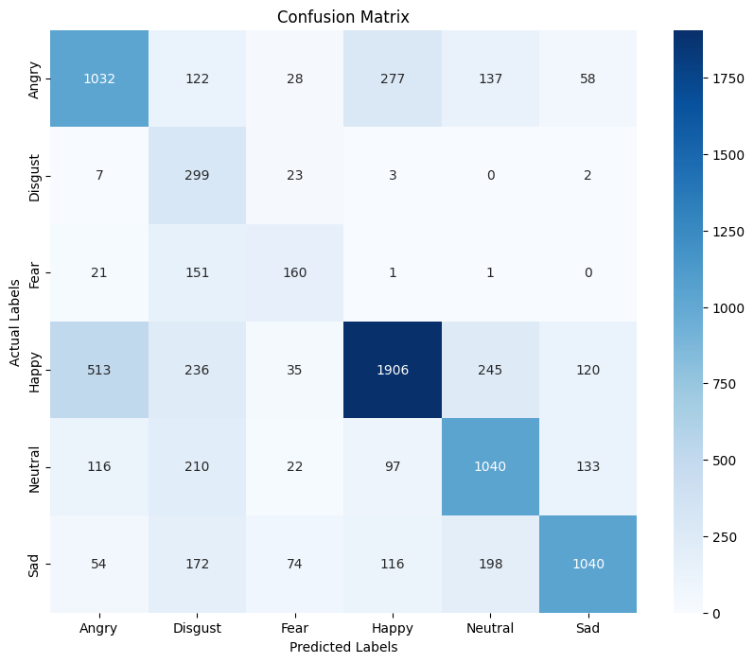
WAVENET (CHAMPION MODEL)

